Slide 1



Insights for Hotels.com Revenue Team
View in Power BI
Last data refresh:
5/5/2023 4:02:49 AM UTC
Downloaded at:
5/5/2023 5:08:56 AM UTC

Slide 2
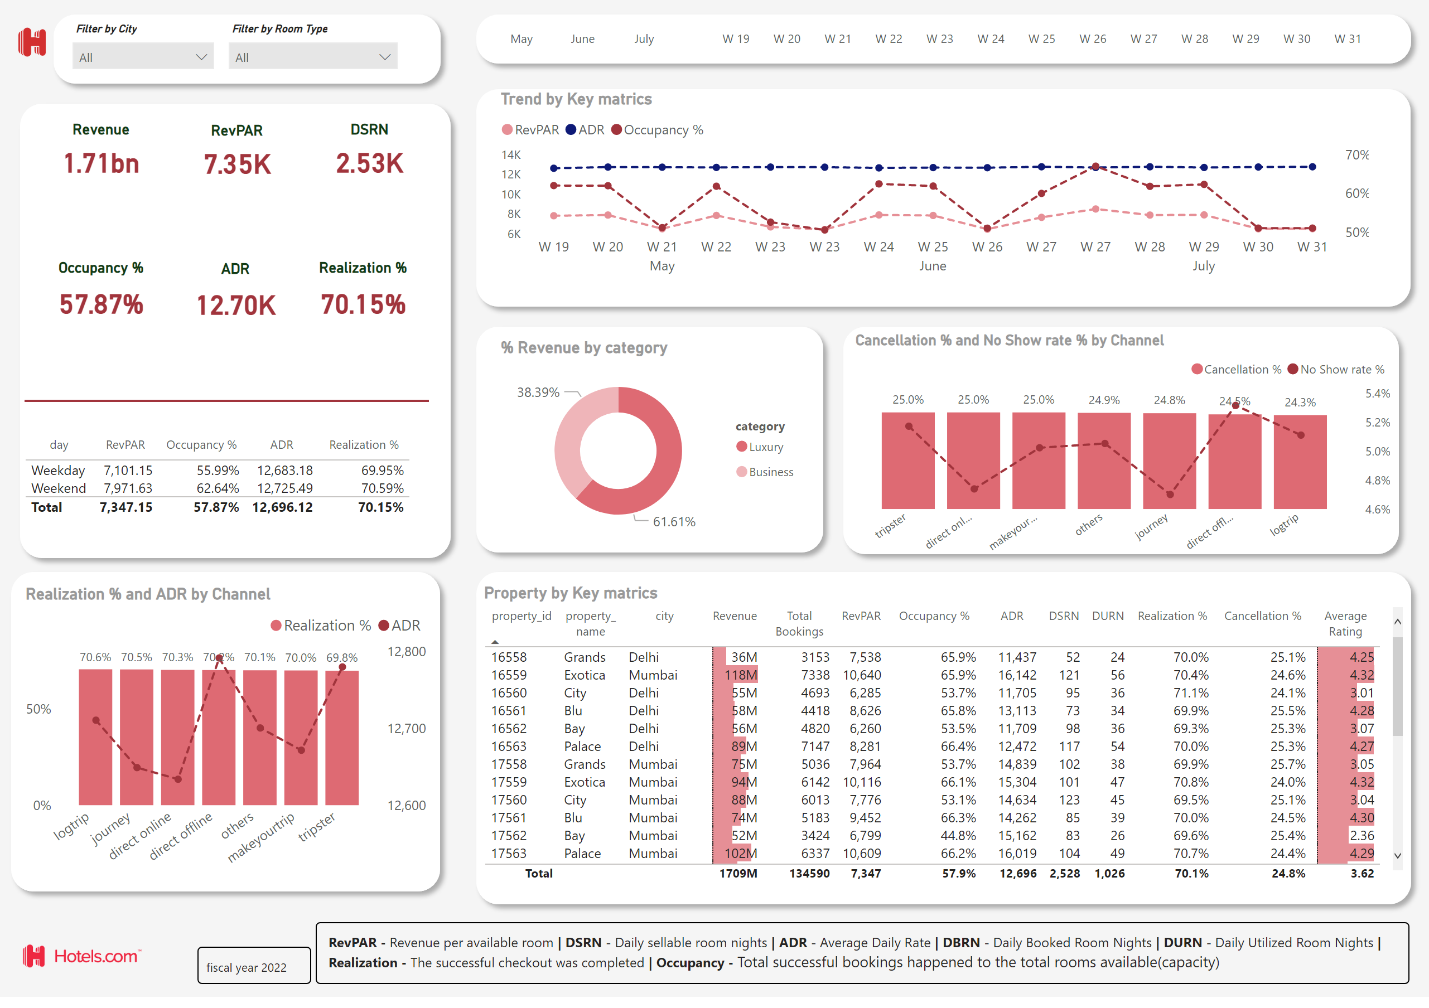
report
Notes:
slicer
No alt text provided
slicer
No alt text provided
image
No alt text provided
slicer
No alt text provided
Property by Key matrics
No alt text provided
% Revenue by category
No alt text provided
tableEx
No alt text provided
Realization % and ADR by Channel
No alt text provided
Trend by Key matrics
No alt text provided
Revenue
No alt text provided
RevPAR
No alt text provided
DSRN
No alt text provided
Occupancy %
No alt text provided
ADR
No alt text provided
Realization %
No alt text provided
slicer
No alt text provided
shape
No alt text provided
shape
No alt text provided
shape
No alt text provided
shape
No alt text provided
shape
No alt text provided
shape
No alt text provided
shape
No alt text provided
shape
No alt text provided
textbox
No alt text provided
image
No alt text provided
shape
No alt text provided
textbox
No alt text provided
Cancellation % and No Show rate % by Channel
No alt text provided

